Slide 1
Java Building Blocks: Understanding the Structure and Syntax of Java Programs
AN OVERVIEW OF OCA CHAPTER ONE
By Abdelrahman Magdy

Slide 2
Java
AGENDA
Today we will cover
Class structure
Package and imports
Objects
Datatypes
Variables
Destroying objects

Slide 3
Class Structure

Slide 4
Class
A class in Java is a basic building block of object-oriented programming. It can be defined as a template that describes the data and behavior associated with the instances of that class

Slide 5
Object
An object in Java is an instance of a class that has its own state and behavior. An object can store data in its fields and perform actions using its methods

Slide 6


Class members
/
FIELDS
METHODS

Slide 7
Fields
/
Fields is variables that belong to the class and can store data or perform actions
It cares about state of object
It is also called attributes

Slide 8
Methods
/
Functions that are associated with class to perform actions in object
It is also called behaviors

Slide 9
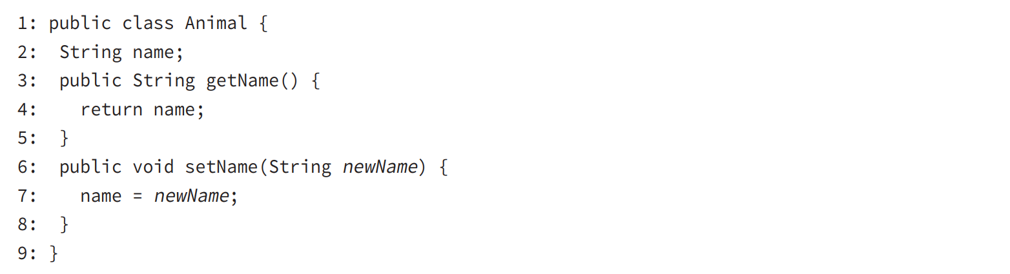
Class example

Slide 10
Class vs .files
Each class is defined on its own *.java file
The file should have the same name of class
The file may contain multiple class
The class with public keyword should match file name
EX ( Class name : Example , File name : Example.java )

Slide 11
main() method
Java program begins its execution with its main() method
It should be static
The program has only one main method
JVM created an object from the class that contain main()

Slide 12
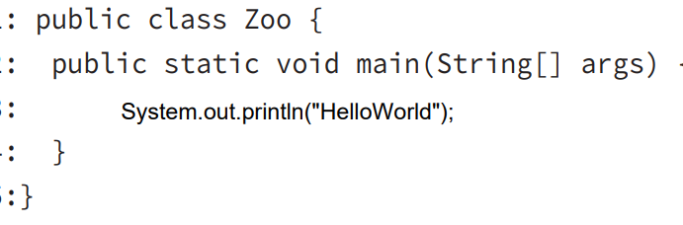
main() example

Slide 13

Compilation

Slide 14
Comment
01
02
03
Single line comment
( // comment)
Multi-line comment
( /*
comment
*/ )
Document comment
( /**
comment
*/ )

Slide 15
Package and imports

Slide 16
Package
Package is a way to organize classes in java
Package encapsulates a group of sub classes, subpackages and interfaces
Package prevents naming conflicts

Slide 17
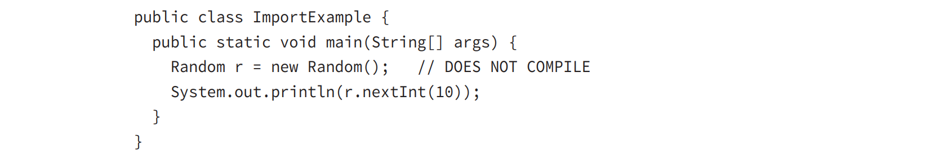
Package

Slide 18
Import
Import used to import a package , class or interface from another source
Import statement tells the compiler which a package to look in find a class
To import a package use ( import ) statement

Slide 19
Import
import java.util.Random; // import tells us where to find Random public class ImportExample
{
public static void main(String[] args)
{
Random r = new Random(); System.out.println(r.nextInt(10)); // print a number between 0 and 9
}
}

Slide 20
Imports example
Import
import java.nio.file.Files;
Import
import java.nio.file.Paths;
Import
Import java.util.*;

Slide 21
Objects

Slide 22


Object Creating
Our programs wouldn’t be able to do anything useful if we didn’t have the ability to create new objects
new keyword used to create an object ( new Object() )

Slide 23
Constructor
It is a special type of method that has the same name of class
It does not have a return type
The main purpose to initialize fields

Slide 24
Constructor
public class Chicken {
int numEggs = 0;// initialize on line String name;
public Chicken() {
name = "Duke";// initialize in constructor
}
}

Slide 25
Instance initializer
It is a block of code that is called when an object of a class created. It is used to initialize the instance variables of the class.

Slide 26
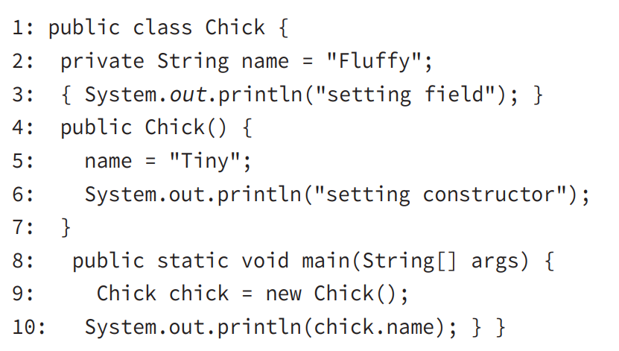
Instance initializer example

Slide 27
Datatypes

Slide 28
Data Types
Primitive types
Reference types

Slide 29
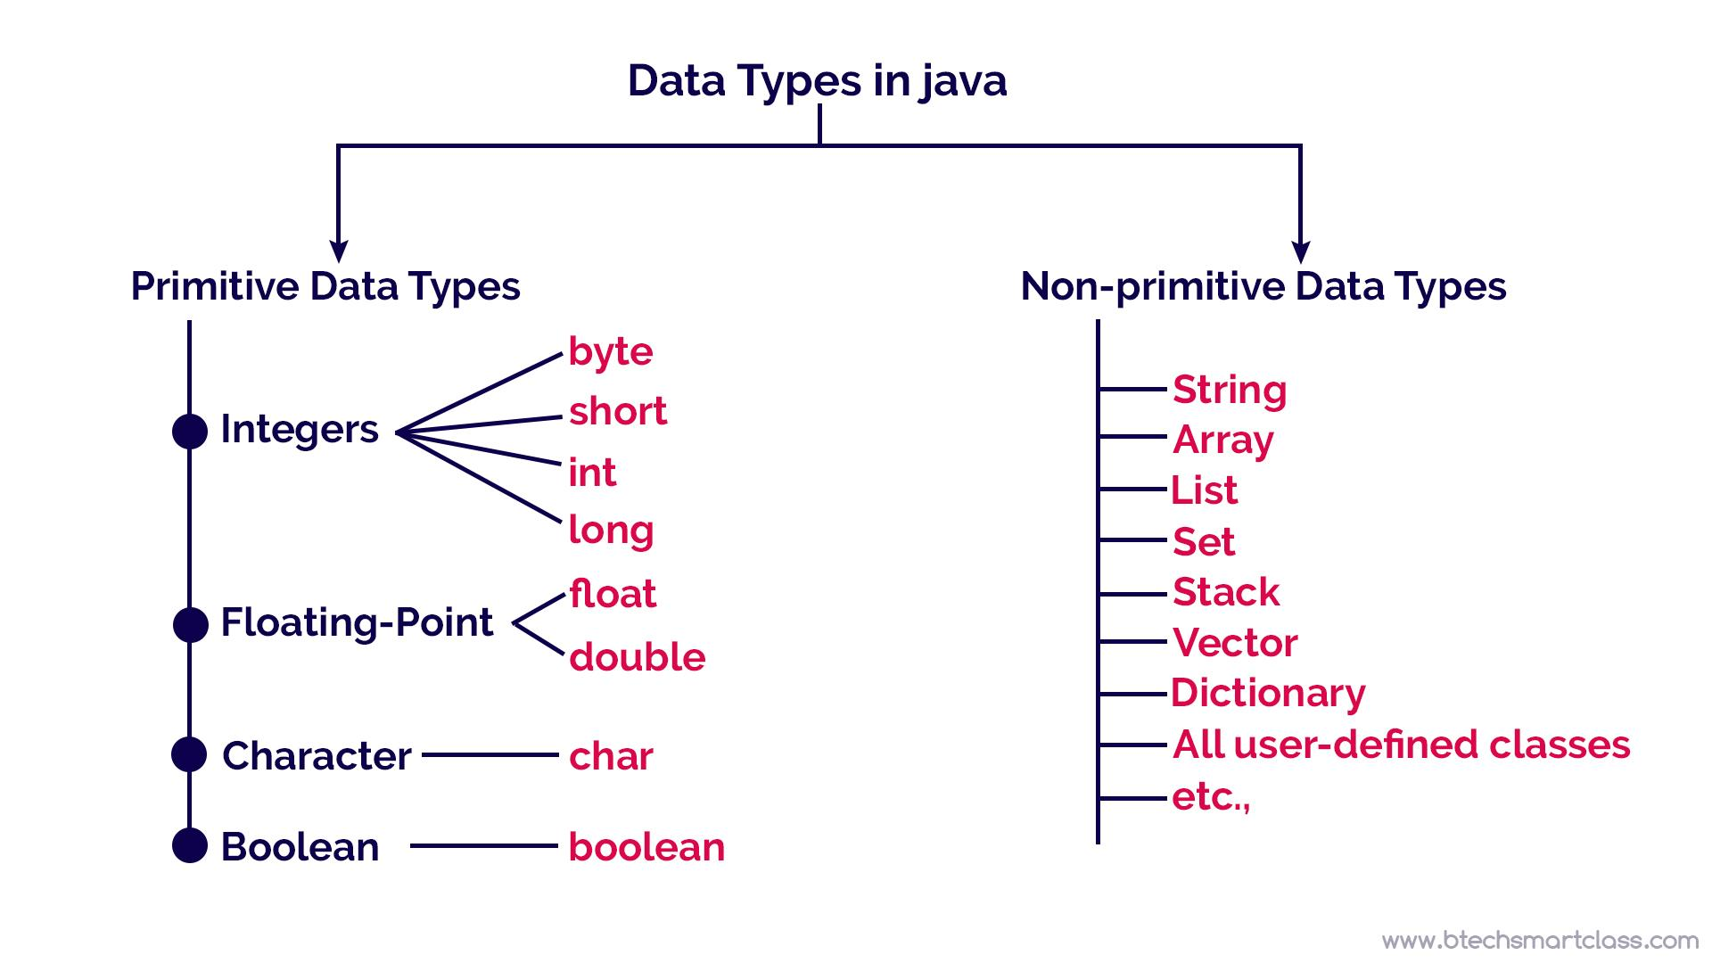
Data types

Slide 30
Primitive Types
Primitive types are build in data types which is introduced by language and they are eight types.

Slide 31
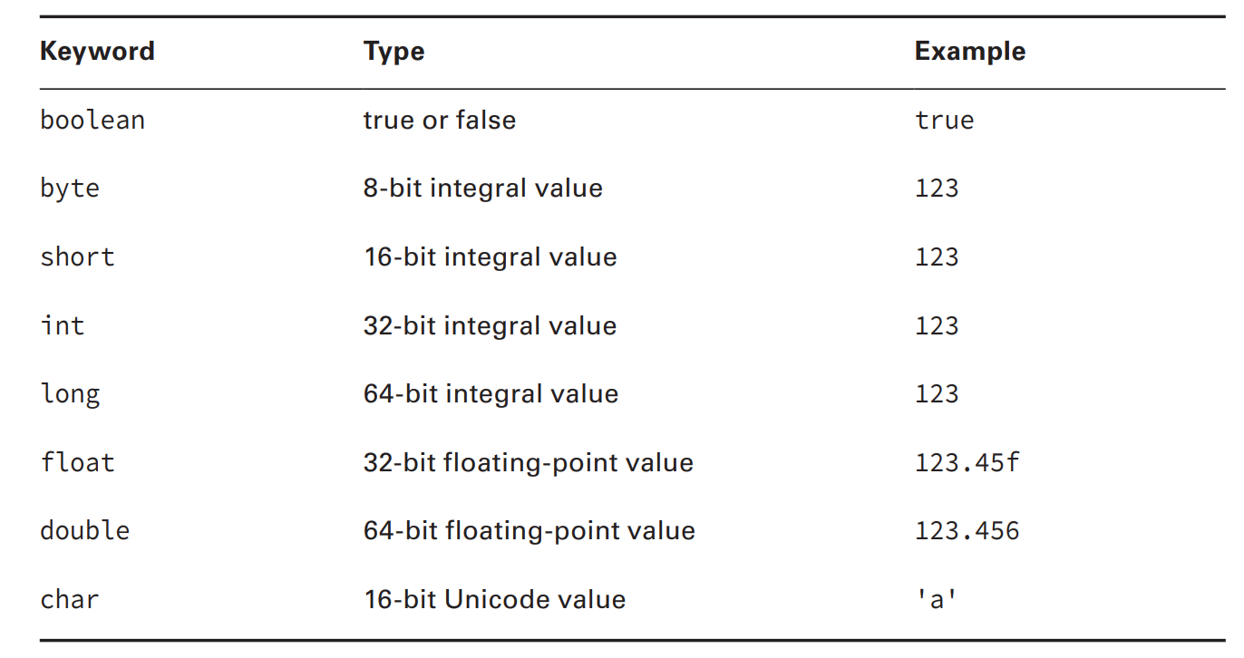
Primitive types

Slide 32
Reference Types
Reference types refer to object by storing the memory address where object is located

Slide 33
Reference types
Reference can be assigned to another object of the same type
Reference can be assigned to a new object using new keyword

Slide 34
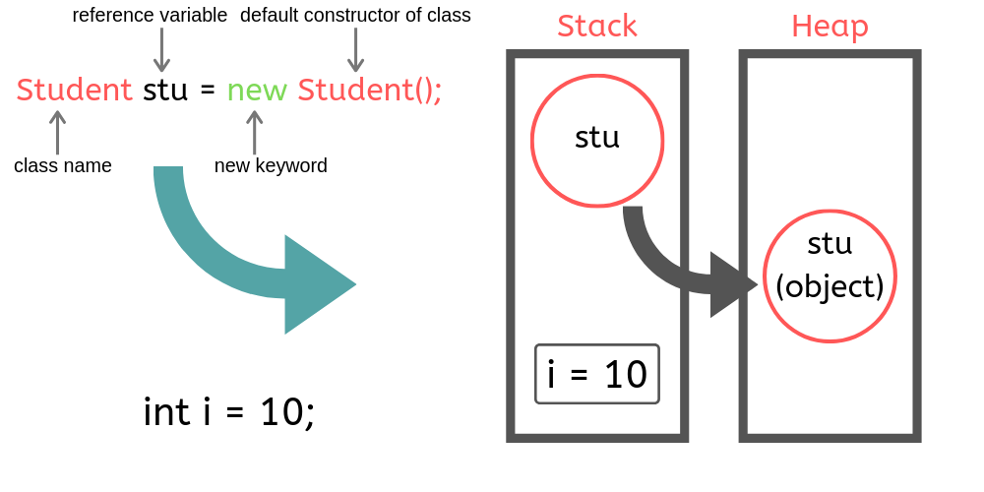
Reference Types

Slide 35
Variables

Slide 36
Variables
It is a small piece of memory data. When you declare a variable, you need to state the variable type along with giving it a name

Slide 37
Variables declaration
To declare a variable you need to specify a data type and name of variable
Ex :
String name
int value = 10
int value = 1_000_000

Slide 38
Naming Conventions
The name must begin with a letter or symbol $ or _
Subsequent characters may also be numbers
Reserved key word is not allowed
Starting with number is not allowed

Slide 39
Example
okidentifier
$OK2Identifier
_alsoOK1d3ntifi3r
__SStillOkbutKnotsonice$

Slide 40
Variables Types
Local variables
Instance and class variables

Slide 41
Local variables
Variables defined inside methods
Must be initialized before using
Do not have default values

Slide 42
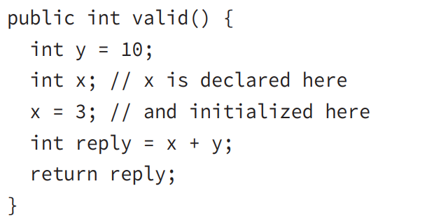
Data types

Slide 43
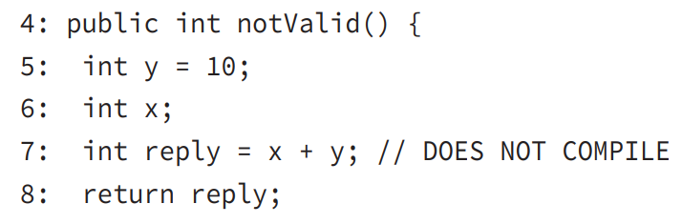
Example

Slide 44
Instance and Class variables
01
02
03
Instance variables called fields
Variables with a static keyword called class variables
Instance and class variables do not have default values

Slide 45
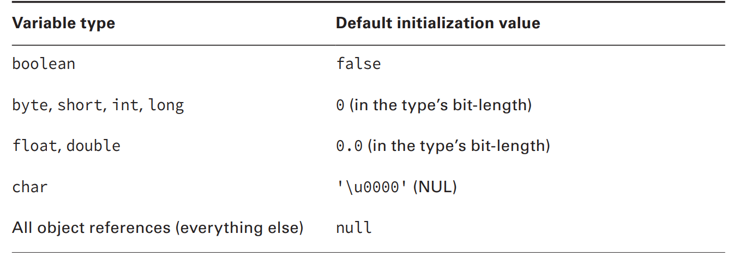
Default values of variables

Slide 46


Variables Scope
Local variables in scope from declaration to the end of object
Instance variables in scope from declaration to the until object garbage collected
Class variables in scope from declaration to the end of the program

Slide 47
Object Destroying

Slide 48

Destroying object
Java automatically takes cares of deleting object data
Java provides a garbage collector to automatically look for objects that aren’t needed anymore

Slide 49

Garbage Collection
Garbage collection refers to the process of automatically freeing memory on the heap by deleting objects that are no longer reachable in your program.

Slide 50
When object becomes unreachable
The object no longer has any references pointing to it.
All references to the object have gone out of scope.

Slide 51
Reference
Reference is variable that has a name and can be used to access the content of object
All References are the same size
Reference can be assigned to another reference, passed to a method, or returned from a method

Slide 52
Object
Objects sits on heap and does not have a name
Objects come in all different shapes and sizes and consume varying amounts of memory
An object cannot be assigned to another object nor can be passed to method

Slide 53
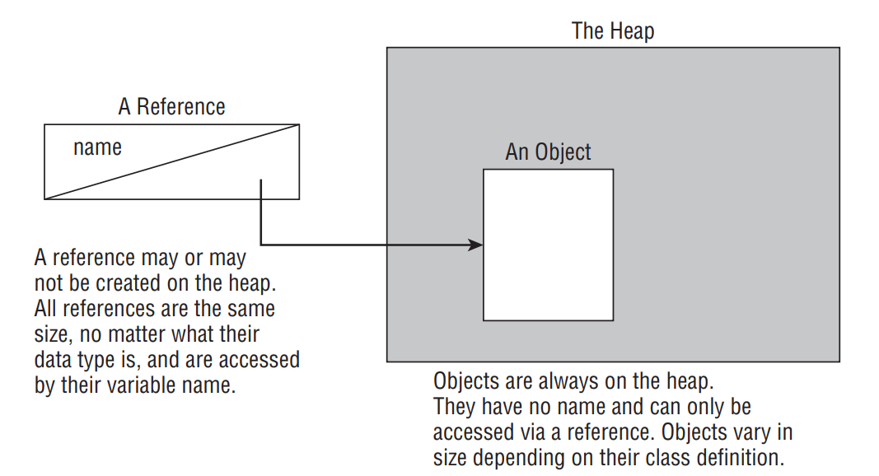
Data types

Slide 54
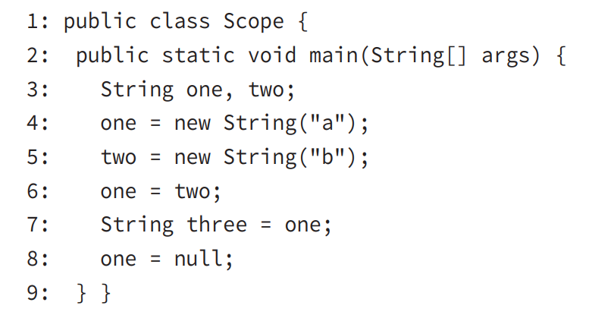
When object become eligible to gc?

Slide 55
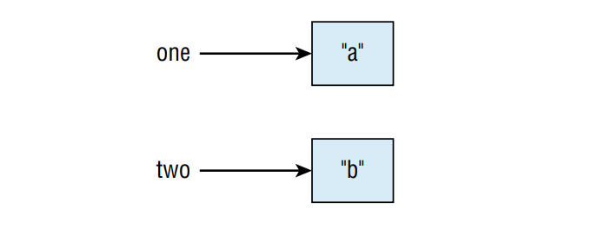
One = new Object(“a”); two = new Object(“b”);

Slide 56
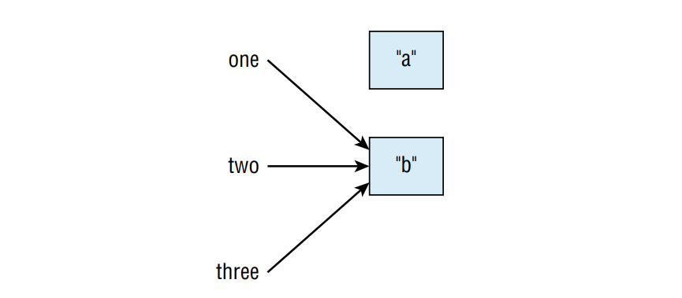
one = two; String three = one; one = null;

Slide 57



finalize
A method that gets called if the garbage collector tries to collect the object
If the garbage collector doesn’t run, the method doesn’t get called
finalize() call could run zero or one time

Slide 58
Thank you

